Slide 1

Training Slide

Slide 2
Name of Trainer
“What will be taught”

Slide 3
Training Content
Intro Track: General Digital Skills
Computer Literacy
Smartphone Literacy
Tour of mobile Apps and Digital platforms

Slide 4
Introduction to Digital Skills

Slide 5
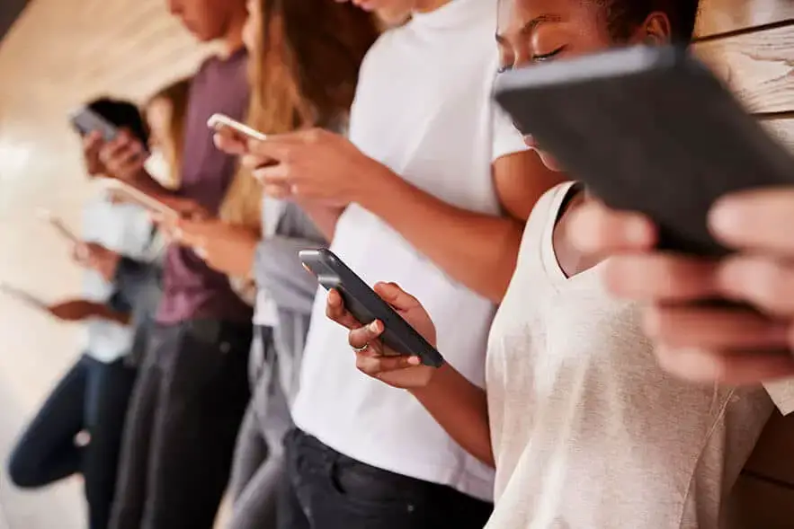
Introduction to Digital Literacy
Notes:
Lesson 1

Slide 6

Introduction to Digital Literacy
Digital literacy is an essential skill in today's fast-paced world. It refers to the ability to confidently and effectively use technology for various tasks and challenges in life.

Slide 7
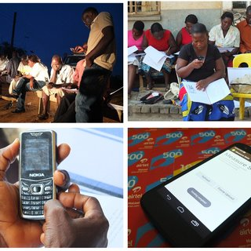
Introduction to Digital Literacy
What are digital skills?
UNESCO’s definition of digital skills Digital skills are defined as a range of abilities to use digital devices, communication applications, and networks to access and manage information.

Slide 8
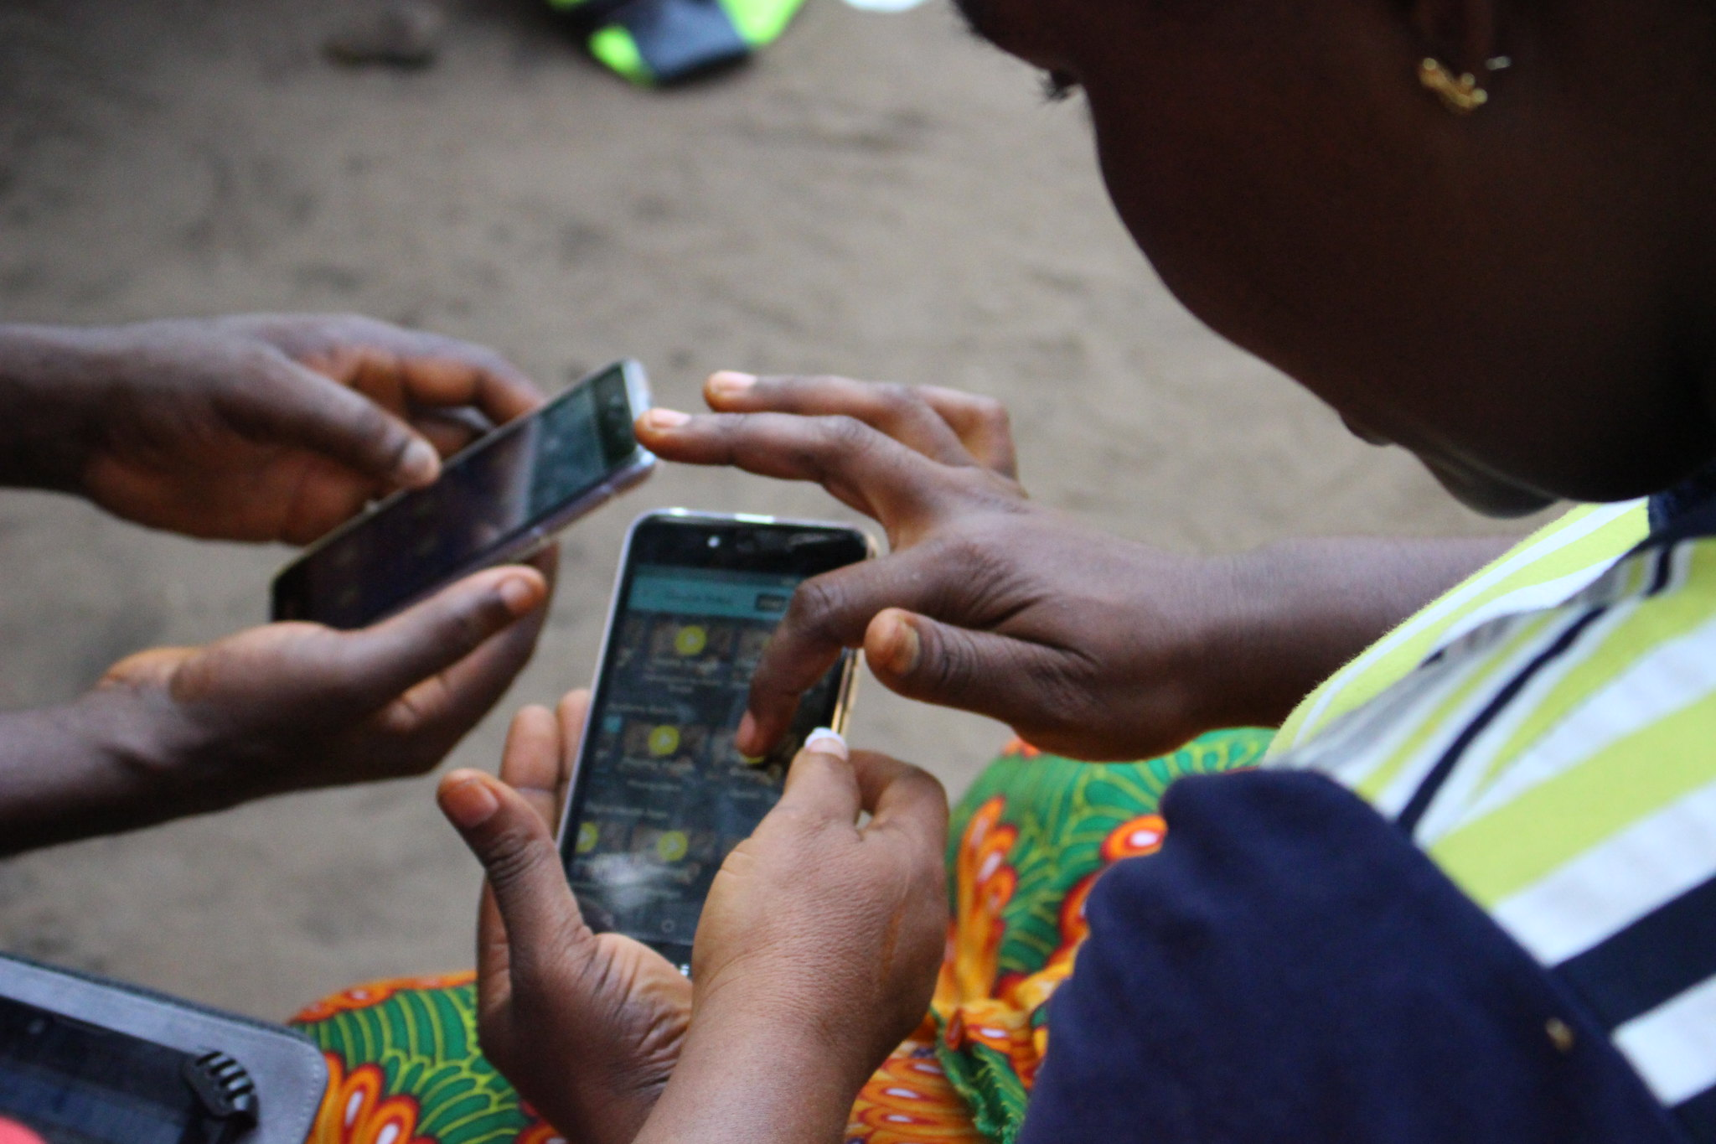
Importance of Digital Literacy
Navigating and thriving in a digital world
Empowering individuals to connect, learn, and succeed
Driving digital transformation in businesses
Supporting educational progress
Bridging the digital divide and promoting digital equity
Enhancing communication, problem-solving, efficiency, and creativity

Slide 9
What Skills Are Necessary for Entry-Level Positions?
For entry-level positions, the bare minimum digital skills required include the ability to carry out tasks, such as:
Communicating
Researching online
Handling sensitive information in virtual
Safely using cloud-based collaboration tools
Creating and managing spreadsheets and online documents
Basic device management
Screen sharing during a video call
Using online calendars, managing your schedule

Slide 10
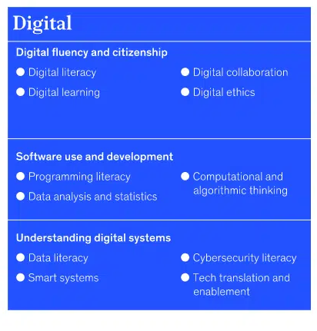
What Are the Critical Digital Skills?
Depending on your career trajectory, you may need additional skills that pertain to your specific role.
Digital skills in the workplace can include
content creation,
e-commerce,
network and information security,
UX/UI design,
digital marketing,
social media marketing, and
data analytics.
Notes:
Identify real-life scenarios where digital skills are essential, such as online banking, job searching, or remote communication with students

Slide 11
Training Exercises
Mention skills that you have now at your current stage
What are the skills you think you need to have?

Slide 12
Computer Literacy

Slide 13

Computer Literacy
Understand the basics of computer hardware and software
Explore different operating systems (Windows, macOS)
Navigate the desktop, managing files and folders

Slide 14
What is a computer?

Slide 15
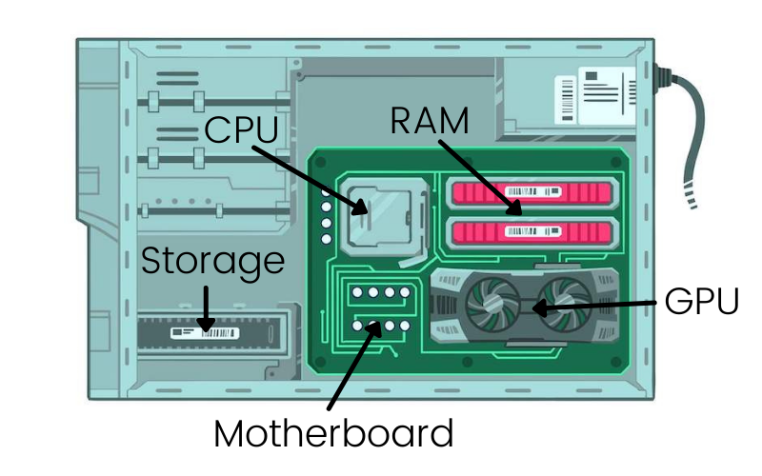
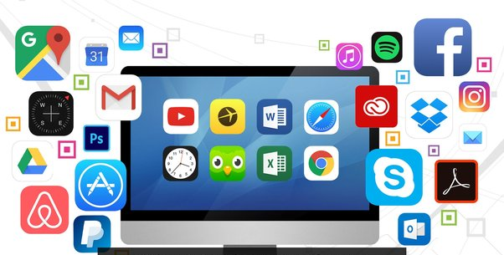
Hardware & Software

Slide 16
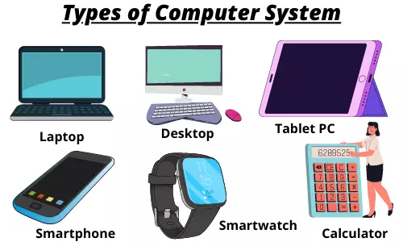

Slide 17

Types of Computer
Server
Notes:
Give General Class exercise: Intro Track: General Digital Skills

Slide 18
Training Exercises
Intro Track: General Digital Skills
What are the types of computer
Mention parts of a computer that you know?

Slide 19
Operating System
An operating system is simply defined as software that lets you manage a computer's hardware and resources while offering some common services that allow you to run different programs.

Slide 20
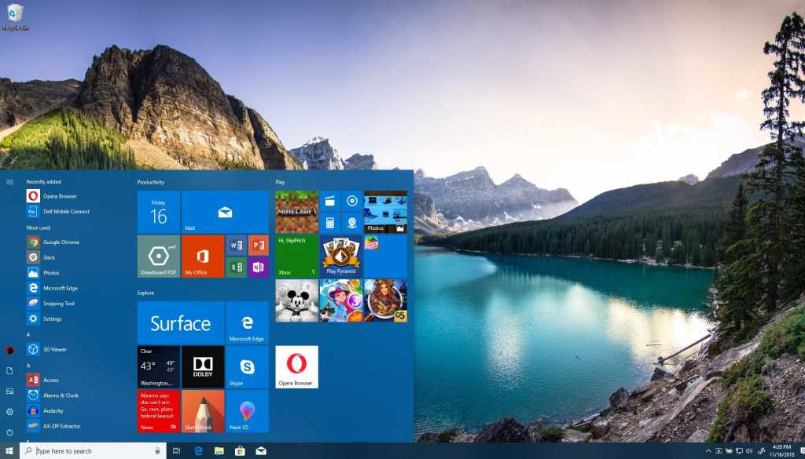
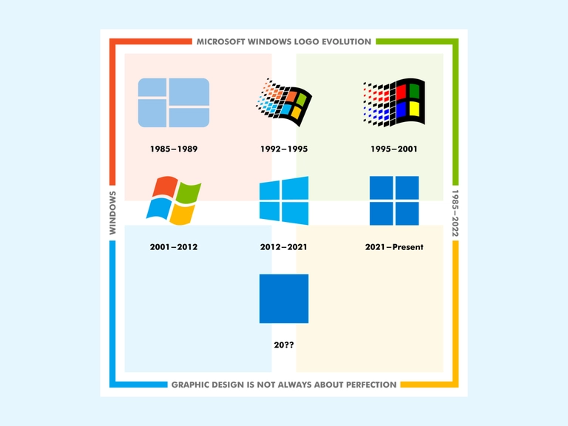
Windows

Slide 21
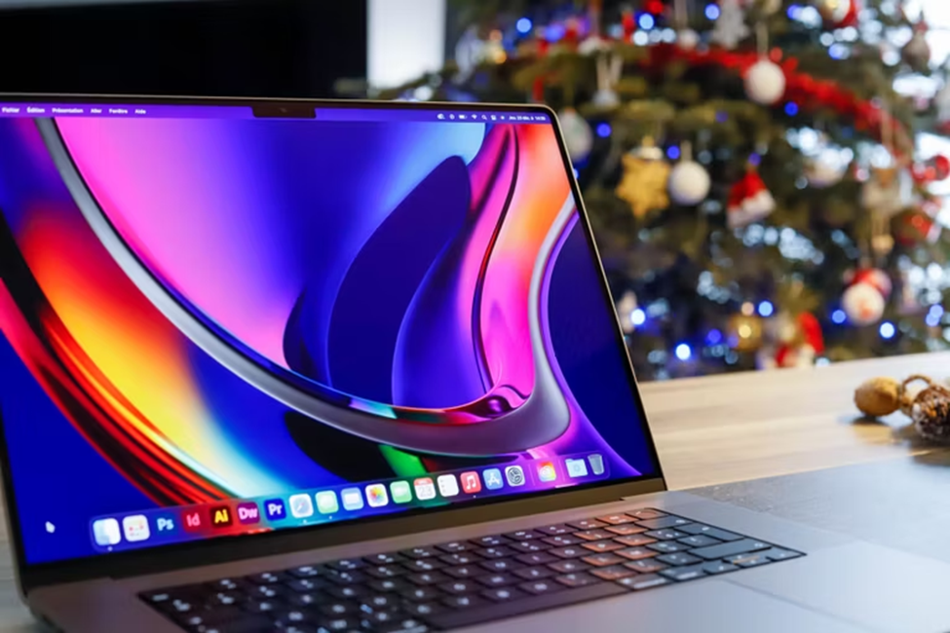

macOS

Slide 22
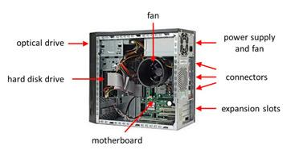
Basic Parts of a Computer
Computer Case

Slide 23

Basic Parts of a Computer
Monitor

Slide 24
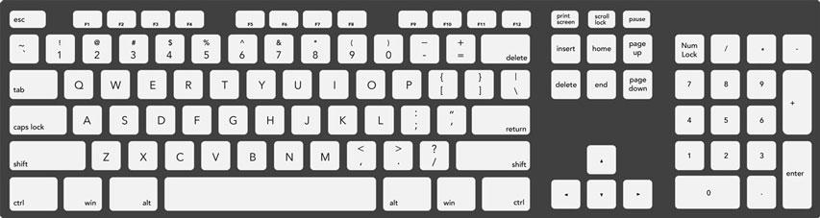
Basic Parts of a Computer
Keyboard

Slide 25

Basic Parts of a Computer
Mouse

Slide 26
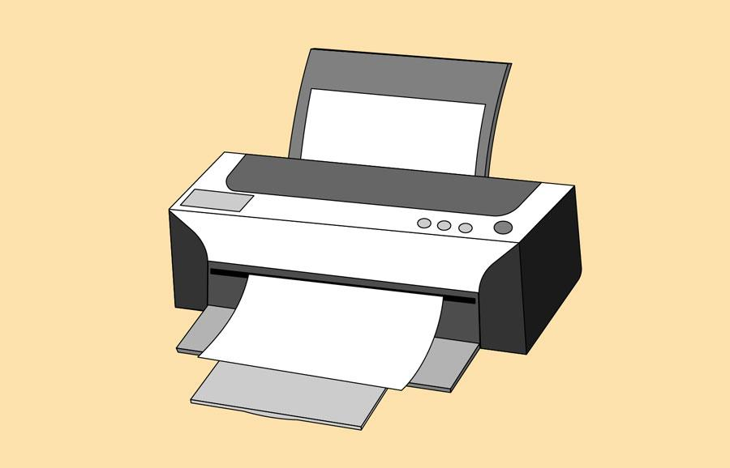


Peripherals you can use with your computer
Printer
Headphone & Speakers
Webcam

Slide 27
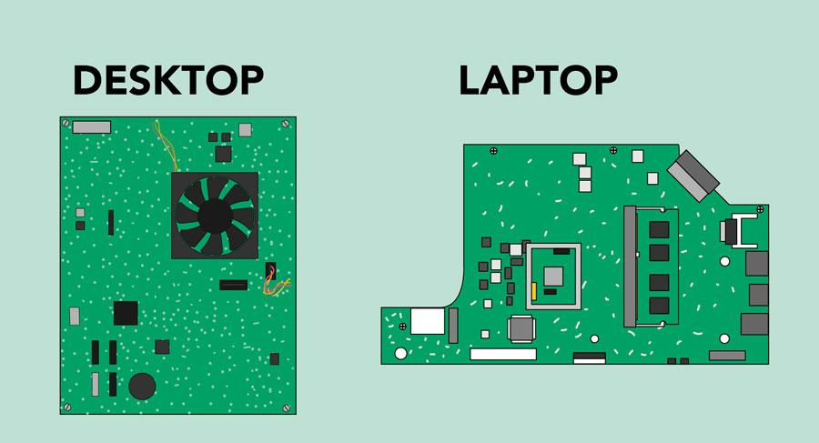
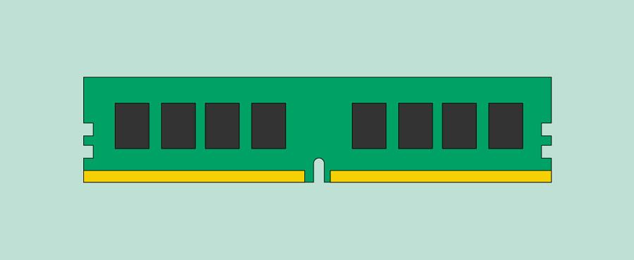
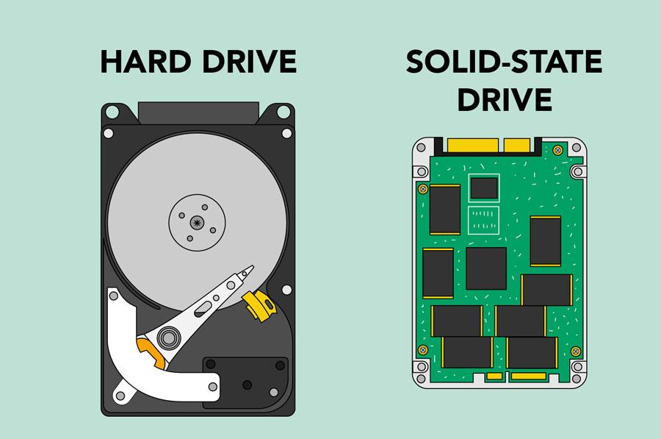


Inside a computer
RAM
Power Supply Unit
CPU/Processor

Slide 28
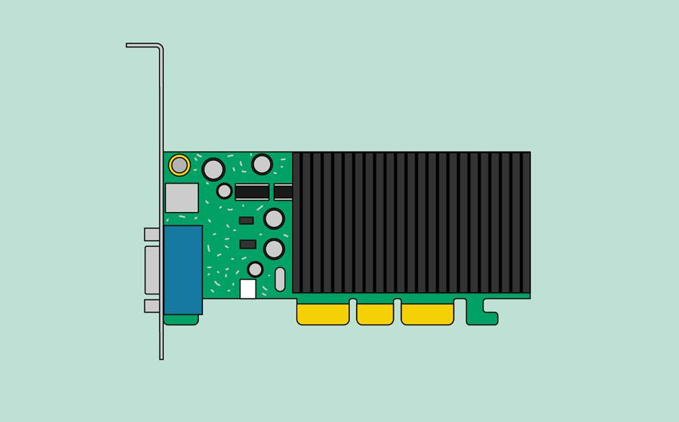
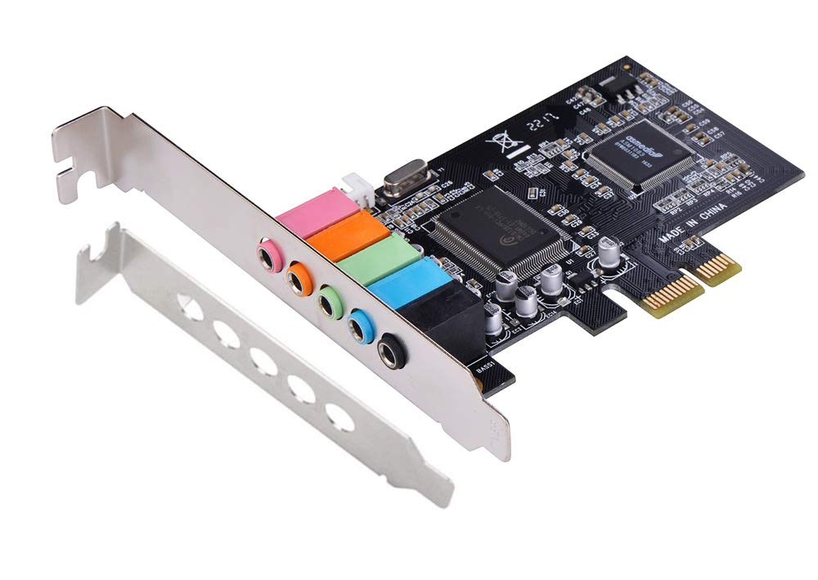
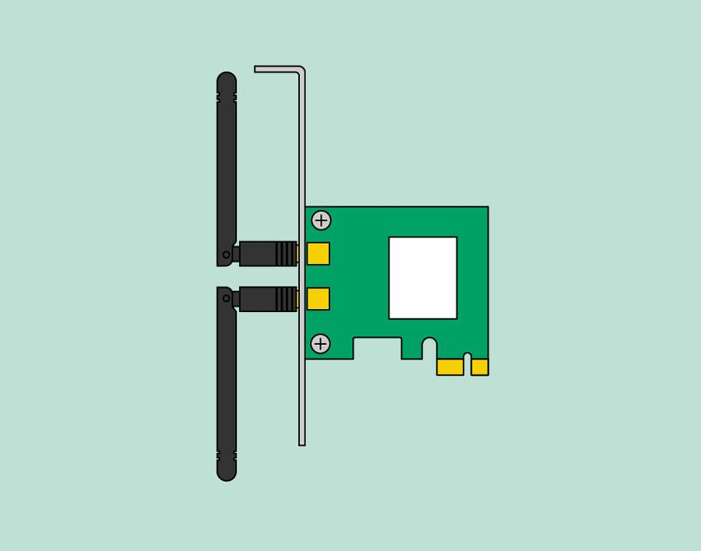

Expansion Cards
Sound Card
Video Card
Network Card
Bluetooth Card

Slide 29
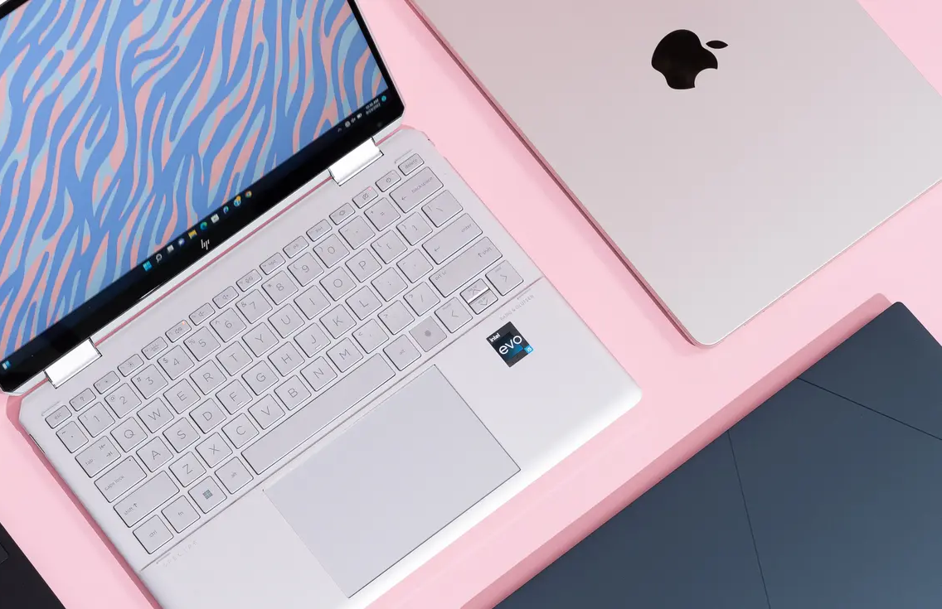
What is a laptop computer?
A laptop is a personal computer that can be easily moved and used in a variety of locations.
Notes:
Give General Class exercise: Intro Track: General Digital Skills

Slide 30
Training Exercises
Intro Track: General Digital Skills
Mention two (2) parts of a desktop computer and it’s equivalent on a laptop

Slide 31


Navigating Windows

Slide 32
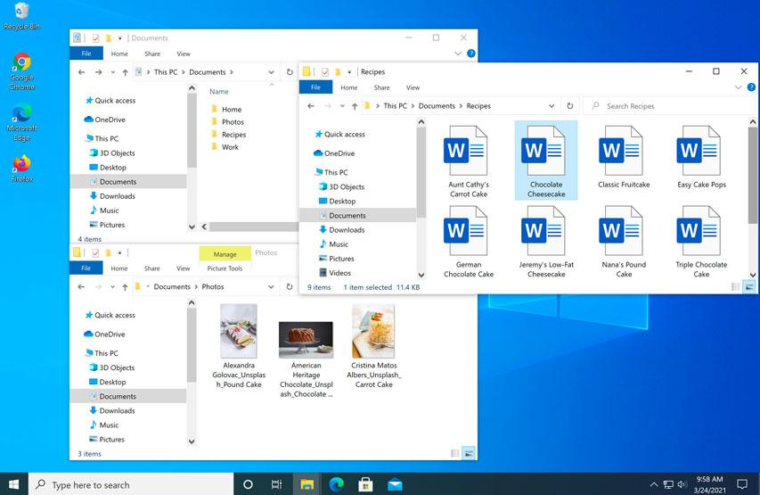
The desktop
Notes:
Open your desktop and show students around. Use the project folder and the file content

Slide 33

Files and Folders
Notes:
Use the project folder and the file content on your

Slide 34

Common computer tasks
The Menu bar
Cut, copy, and paste
Undoing changes
Notes:
Give General Class exercise: Intro Track: General Digital Skills

Slide 35
Training Exercises
Intro Track: General Digital Skills
Create a txt file called “My Digital Training”, create a folder called LDTP both on your window desktop
Copy the txt file and paste in the LDTP folder
Rename the LDTP folder to Liberia Digital Training

Slide 36
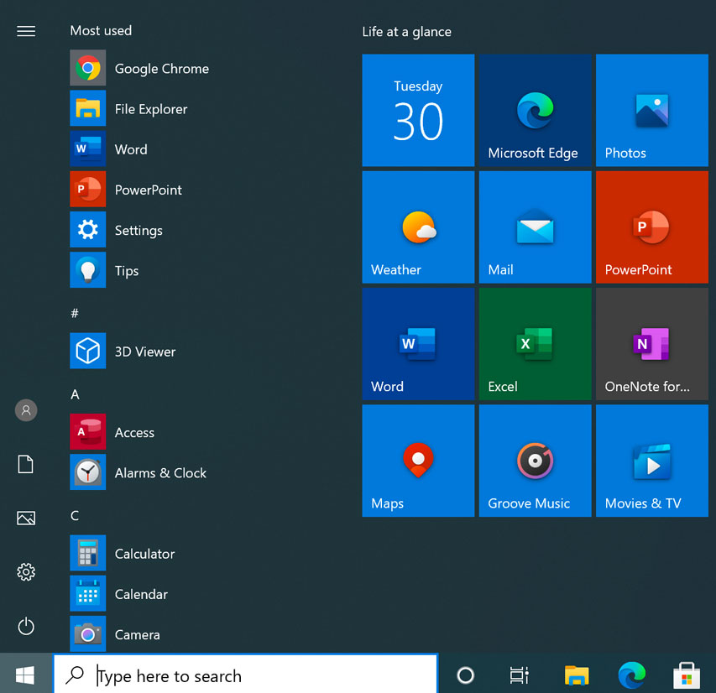
Common applications in Windows
Web browsers
Productivity
Media
Settings
Notes:
Open your laptop and show student around as you teach Prepare to give General Class exercise: Intro Track: General Digital Skills

Slide 37
Training Exercises
On your windows desktop click all programs to see a complete list of applications.
Name 5 applications you can see

Slide 38

Word 2016: Getting Started with Word
Notes:
Open your Microsoft Word and show students around. Give General Class exercise: Intro Track: General Digital Skills

Slide 39
Training Exercises
Challenge!
Open Word 2016, and create a blank document.
Change the Ribbon Display Options to Show Tabs.
Using Customize Quick Access Toolbar, add New, Quick Print, and Spelling & Grammar.
In the Tell me bar, type Shape and press Enter.
Choose a shape from the menu, and double-click somewhere on your document.
Show the Ruler if it is not already visible.
Zoom the document to 120%.
Change the Document view to Web Layout.
Change the Ribbon Display Options back to Show Tabs and Commands, and change the Document View back to Print Layout.

Slide 40
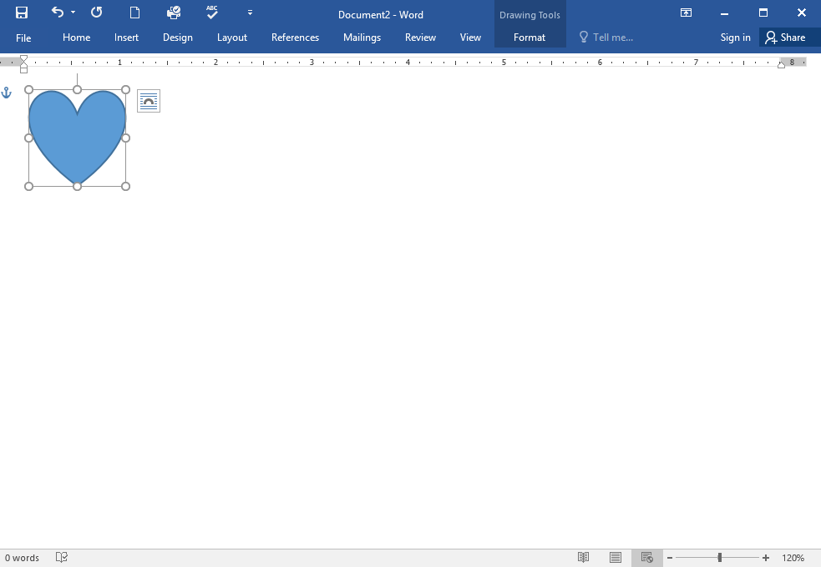
When you're finished, your document should look something like this:

Slide 41

PowerPoint: Getting Started with PowerPoint
Notes:
Open your Microsoft PowerPoint and show students around. Give General Class exercise: Intro Track: General Digital Skills

Slide 42
Training Exercises
Challenge!
Open PowerPoint and create a blank presentation.
Change the Ribbon Display Options to Show Tabs.
Click the drop-down arrow next to the Quick Access Toolbar and add New, Quick Print, and Spelling.
In the Tell me bar, type Shape and press Enter.
Choose a shape from the menu, then double-click somewhere on your slide.
Show the Ruler if it is not already visible.
Zoom the presentation to 120%.

Slide 43
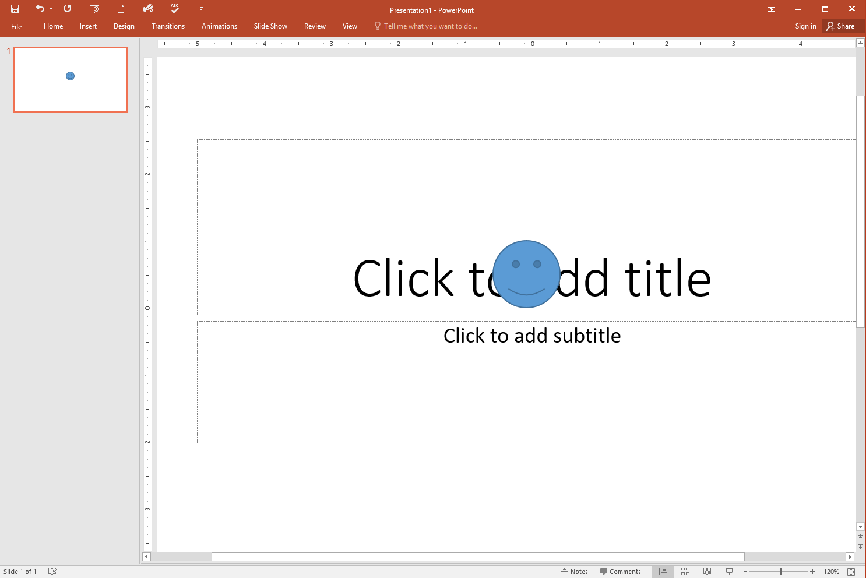
When you're finished, your presentation should look something like this:

Slide 44

Excel 2016: Getting Started with Excel
Notes:
Open your Microsoft Excel and show students around. Give General Class exercise: Intro Track: General Digital Skills

Slide 45
Training Exercises
Challenge!
Open Excel 2016.
Click Blank Workbook to open a new spreadsheet.
Change the Ribbon Display Options to Show Tabs.
Using the Customize Quick Access Toolbar, click to add New, Quick Print, and Spelling.
In the Tell me bar, type the word Color. Hover over Fill Color and choose a yellow. This will fill a cell with the color yellow.
Change the worksheet view to the Page Layout option.

Slide 46
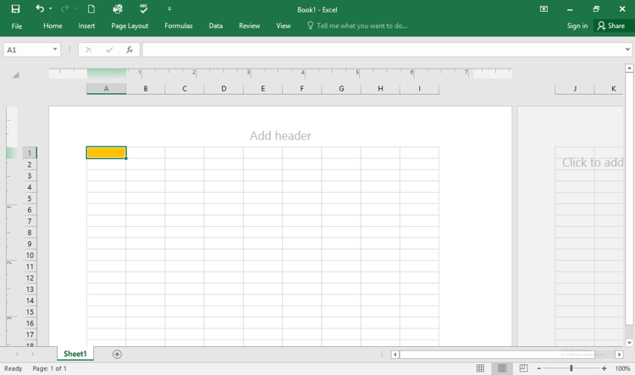
When you're finished, your screen should look like this:

Slide 47
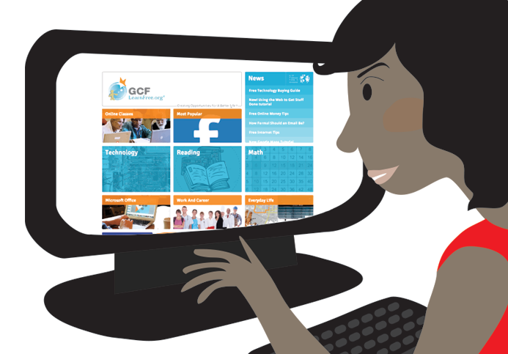
Internet Fundamentals and Web Browsing

Slide 48
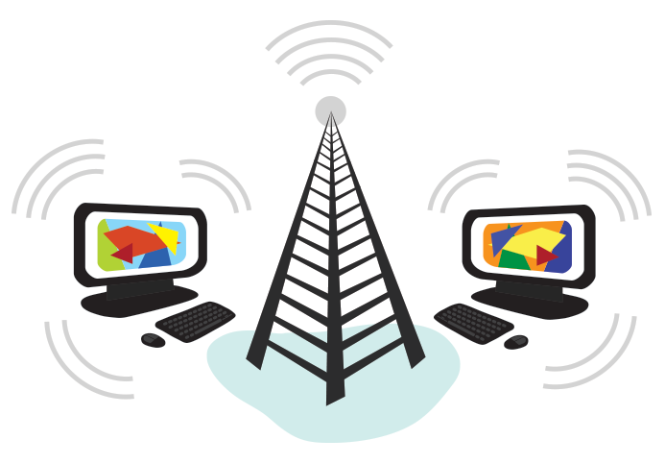
Internet Fundamentals and Web Browsing
What is the Internet?

Slide 49

Internet Fundamentals and Web Browsing
What is the Web?

Slide 50

What Can You Do Online?
Finding information online
Email
Social networking
Chat and instant messaging
Online media
Everyday tasks

Slide 51
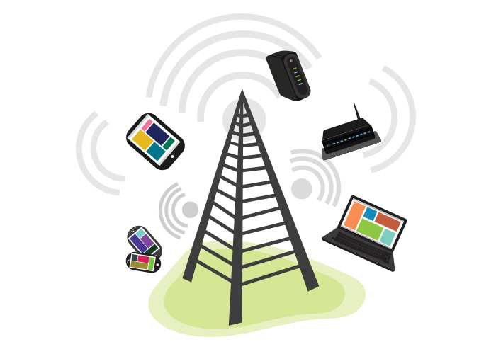
Connecting to the Internet

Slide 52


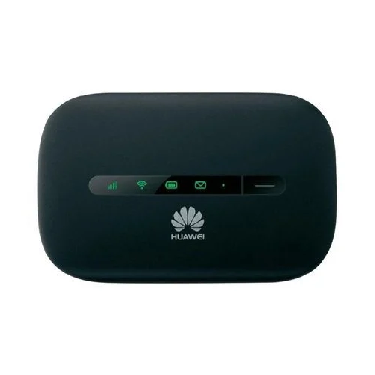
Connecting to the Internet
Hardware needed
Notes:
Show students this hardwares if available

Slide 53
Exercise
Flomo was given an assignment from school, his father took their only source of internet that they use at home to work. Flomo called his father with the smart phone on whatsapp, there was sufficient data. He couldn’t reach his father but needed to work on his laptop.
What could be the hardware they all use at home o connect to the internet?
What should Flomo do since he must submit his assignment in the next 1 hour.

Slide 54

Navigating Web Browsers effectively
Notes:
Open your browser, preferably Google chrome and show them around the browser.

Slide 55
Exercise
Search and click on any browser (Google Chrome, firefox or Edge)
Enter the url “www.liberiagoesdigital.org”
Bookmark the page
Save the image logo on your computer using save image as.

Slide 56

Sharing files, Secure Online Communication and Collaboration
Notes:
Open google doc or any other online collaboration tools and show students around

Slide 57
Assignment
Create a file on any collaboration tool, conduct online research on digital skill needed in you field of study or business and add your instructor (using their email) as a collaborator(editor).
Notes:
Instructors are to give their emails for student to add them

Slide 58
Smartphone Literacy

Slide 59

Mobile Phones

Slide 60
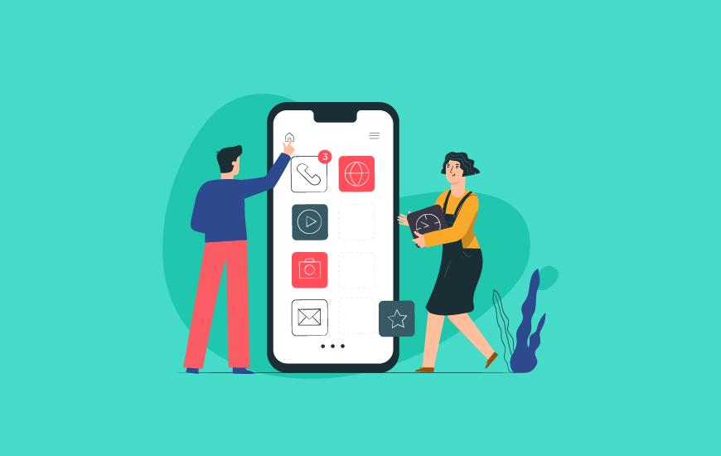
Essential Functions and Apps on Smartphones
Notes:
Participants explore the features and settings of their smartphones, customize their home screens, and practice gesture controls.

Slide 61






Exploring secure communication tools (encrypted messaging, video conferencing)
Notes:
Participants install and configure essential apps such as messaging, email, calendar, and map/navigation apps.

Slide 62
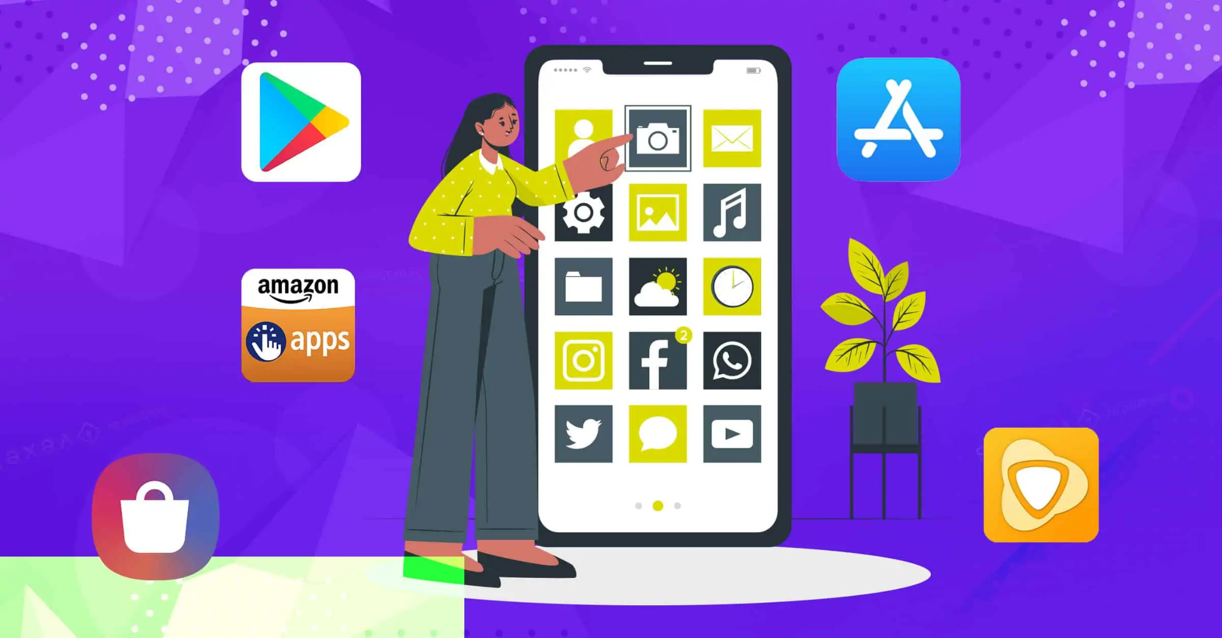
Introduction to Mobile App Stores
Notes:
Ask students to open their app stores, give instruction and navigate as per the training manual. Take note of versions of the app stores. Search for apps related to their interests or professional needs, and download and install selected apps

Slide 63

Navigating, Searching, downloading, and installing apps safely

Slide 64


Navigating, Searching, downloading, and installing apps safely
Notes:
Navigate thee astore along with student. Ask students to download any Liberia own app

Slide 65
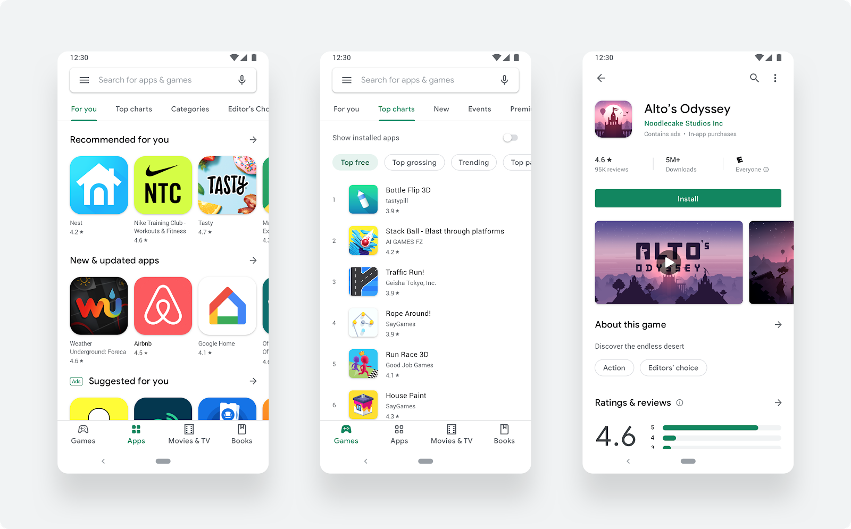
Navigating, Searching, downloading, and installing apps safely
Notes:
Navigate thee astore along with student. Ask students to download any Liberia own app

Slide 66
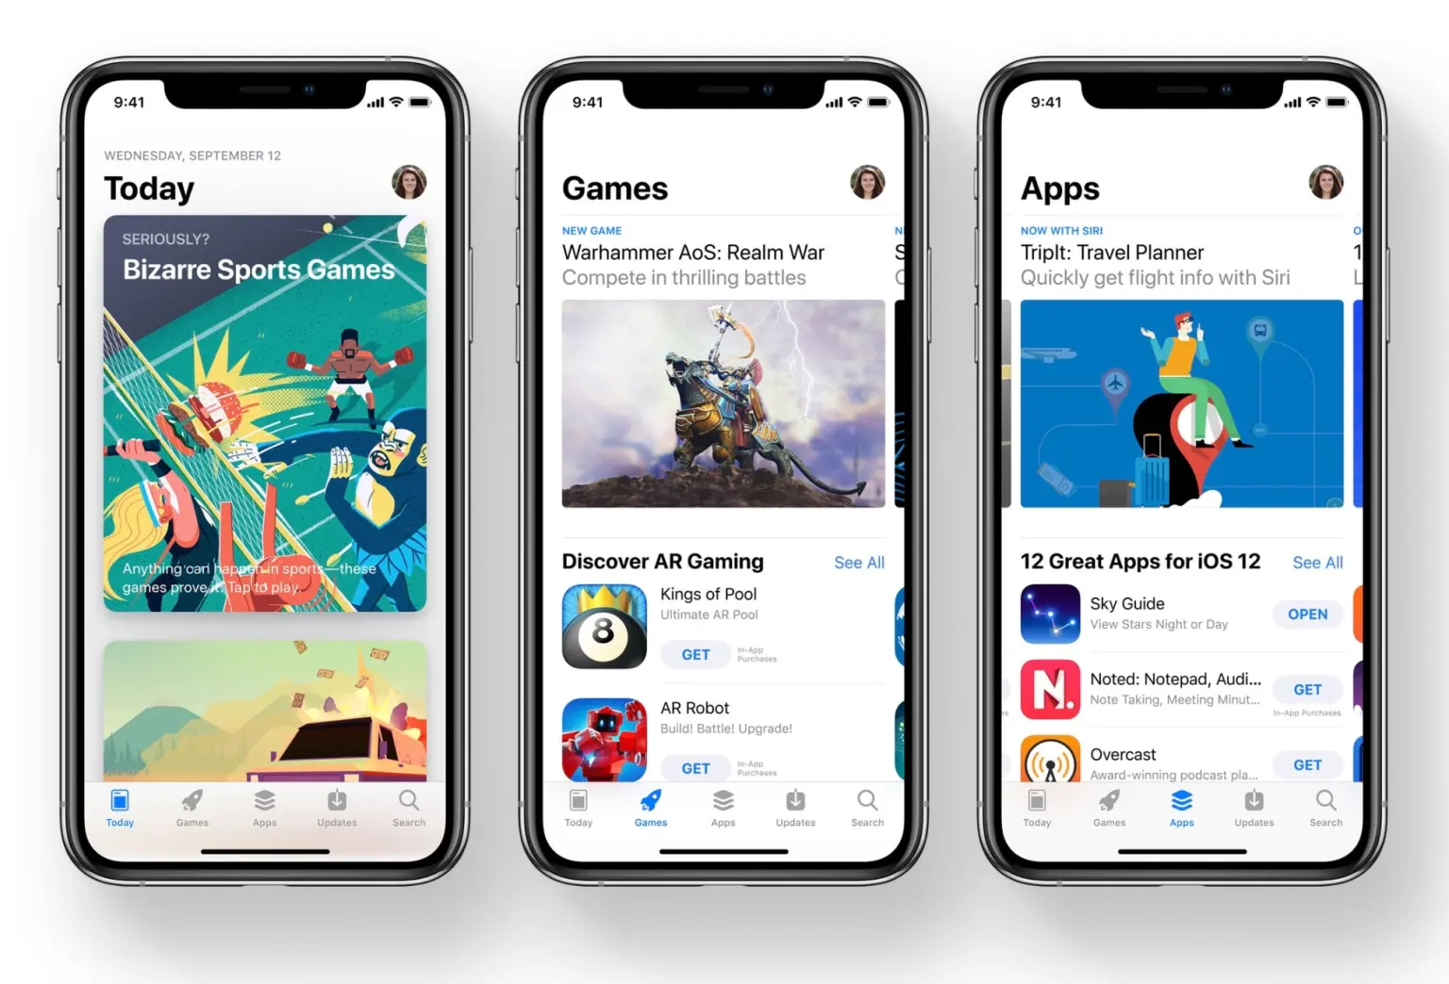
Navigating, Searching, downloading, and installing apps safely
Notes:
Navigate thee astore along with student. Ask students to download any Liberia own app

Slide 67
Exercise
How many essential functions and apps do you have on your phone?
Which of these apps do you use daily
Which of the apps did you just notice?
Download any Liberia own app

Slide 68




Email Communication

Slide 69
Exercise
Create an email
Send an email to your instructor telling LTDP thank you for the training.

Slide 70
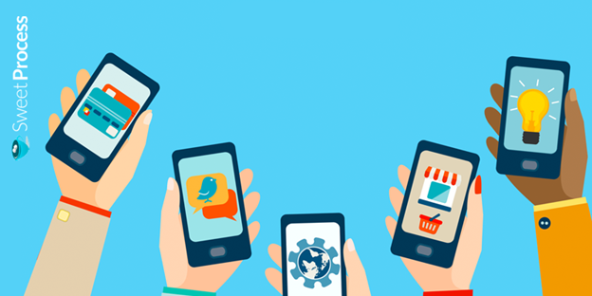

Mobile Apps for Personal Productivity

Slide 71










Productivity apps
Task and Project Management
Note-Taking and Document Management
Time and Focus Management
Calendar and Schedule Management
Health and Fitness
Reading and Learning
Contacts and Address Book
Notes:
Participants explore productivity apps, create to-do

Slide 72
Exploring secure communication tools

Slide 73
Exercise
Name 5 productivity app that you will start to use from now on.
What are the new things you learnt you can do with your phone?
Join the telegram group Digital Liberia and Youth for Exploits.

Slide 74
Tour of Digital Platforms

Slide 75
Tour of Digital platforms for various sectors
Agriculture Sector
Education
Health
Mining & Survey
Transport
Financial

Slide 76
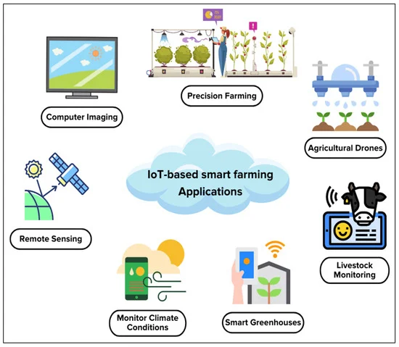
Agriculture

Slide 77
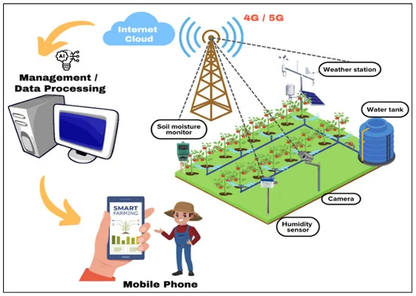
Agriculture

Slide 78
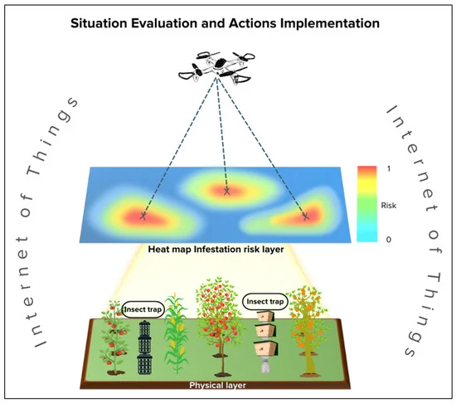
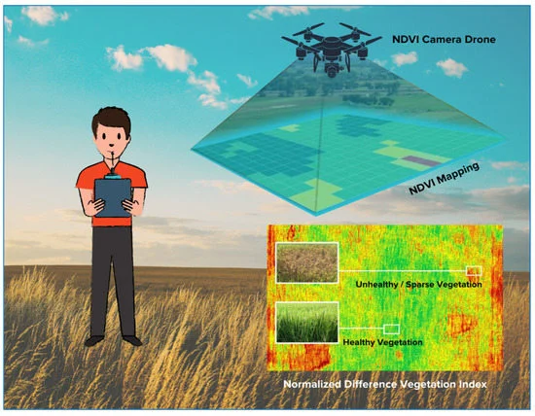
Agriculture

Slide 79
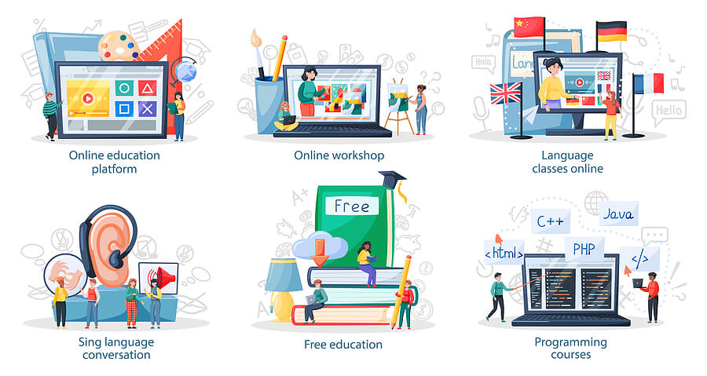
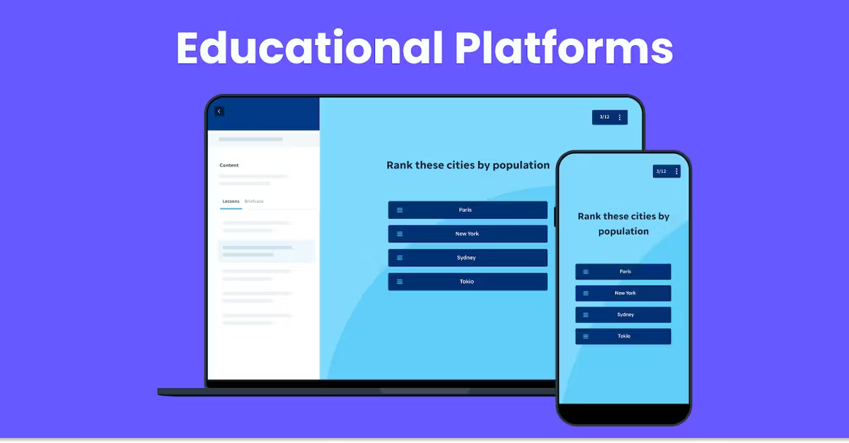
Education and E-Learning Platforms

Slide 80











E-Learning Platforms

Slide 81
Assignment
Join any education platform of your choice and subscribe for learning

Slide 82
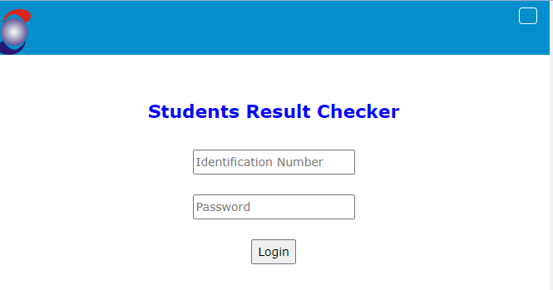
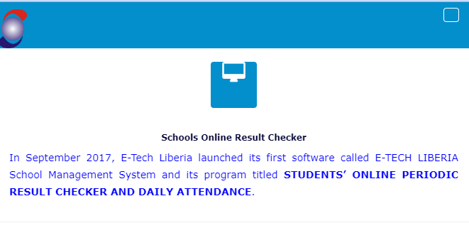
Educational Platforms in Liberia
Etech Liberia
Website :https://www.etechliberia.com/

Slide 83

Educational Platforms in Liberia
SchoolMaSS

Slide 84
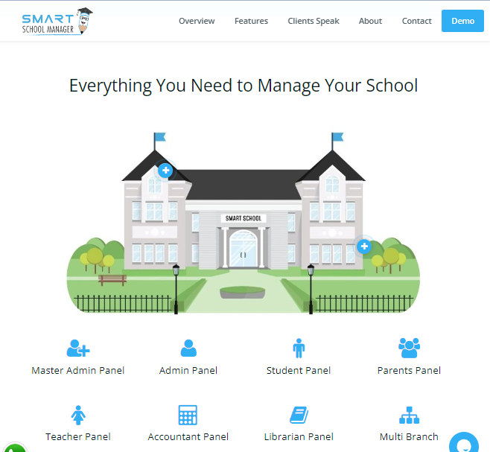
Educational Platforms in Liberia
Smart School Manager

Slide 85
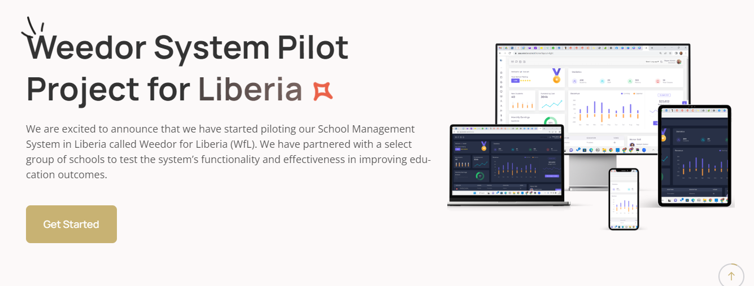
Educational Platforms in Liberia
Weedor

Slide 86

Educational Platforms in Liberia
SchoolLink by Mwentana
https://www.mwetanaschoolink.com/

Slide 87
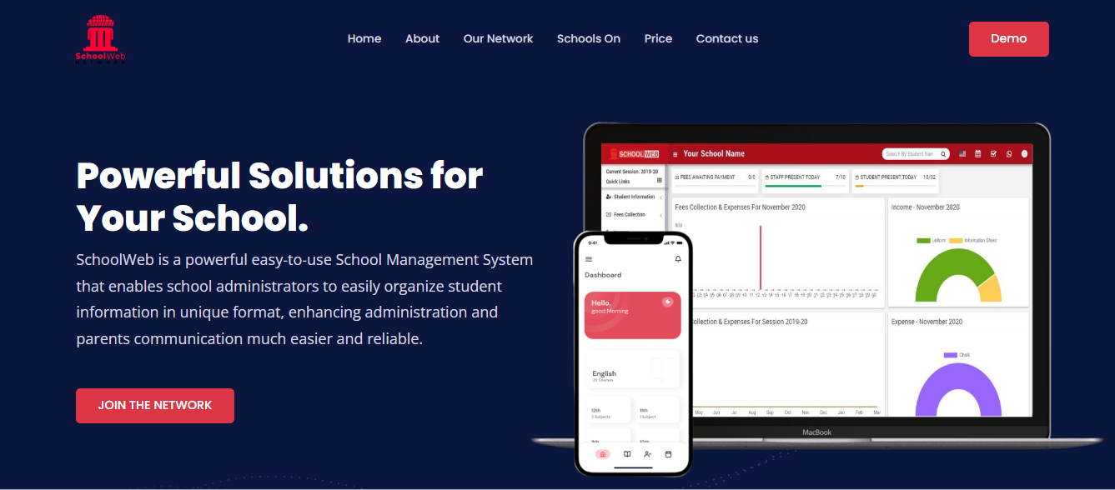
Educational Platforms in Liberia
School Web
https://myschoolmgt.net/

Slide 88
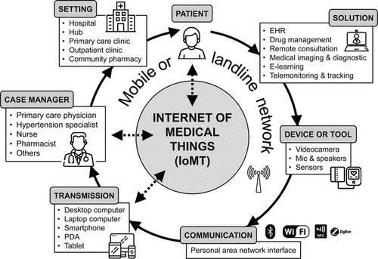
Healthcare

Slide 89




Healthcare

Slide 90
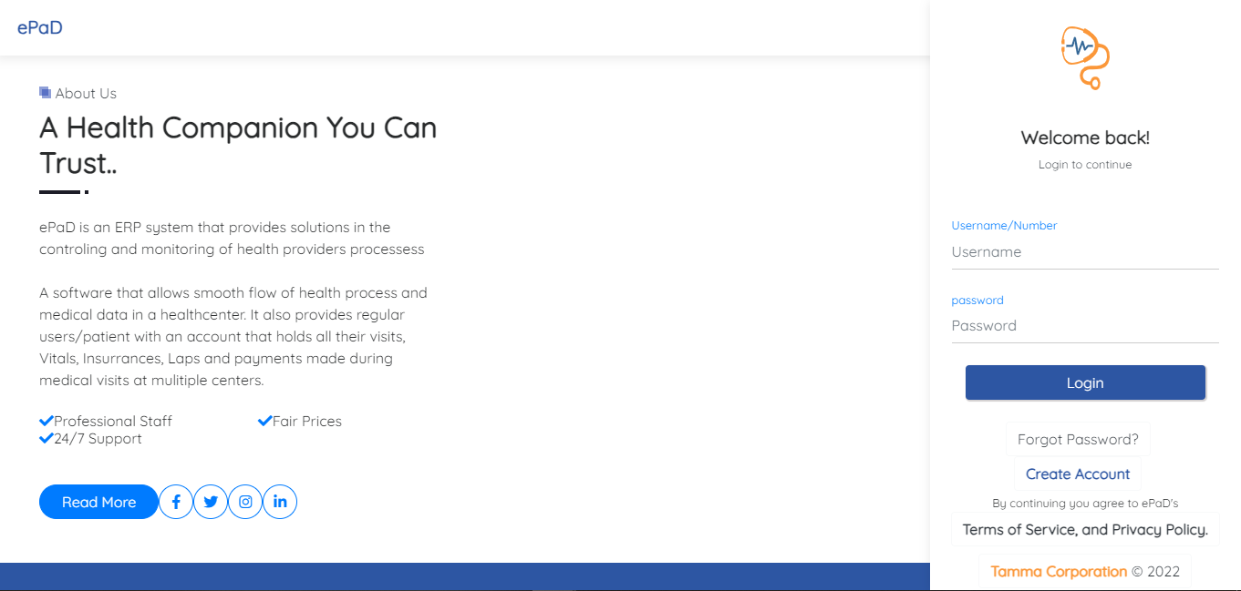
Healthcare

Slide 91

Healthcare

Slide 92
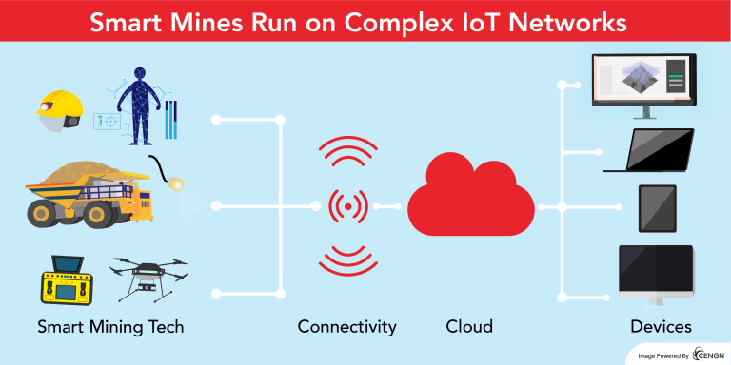
Mining

Slide 93
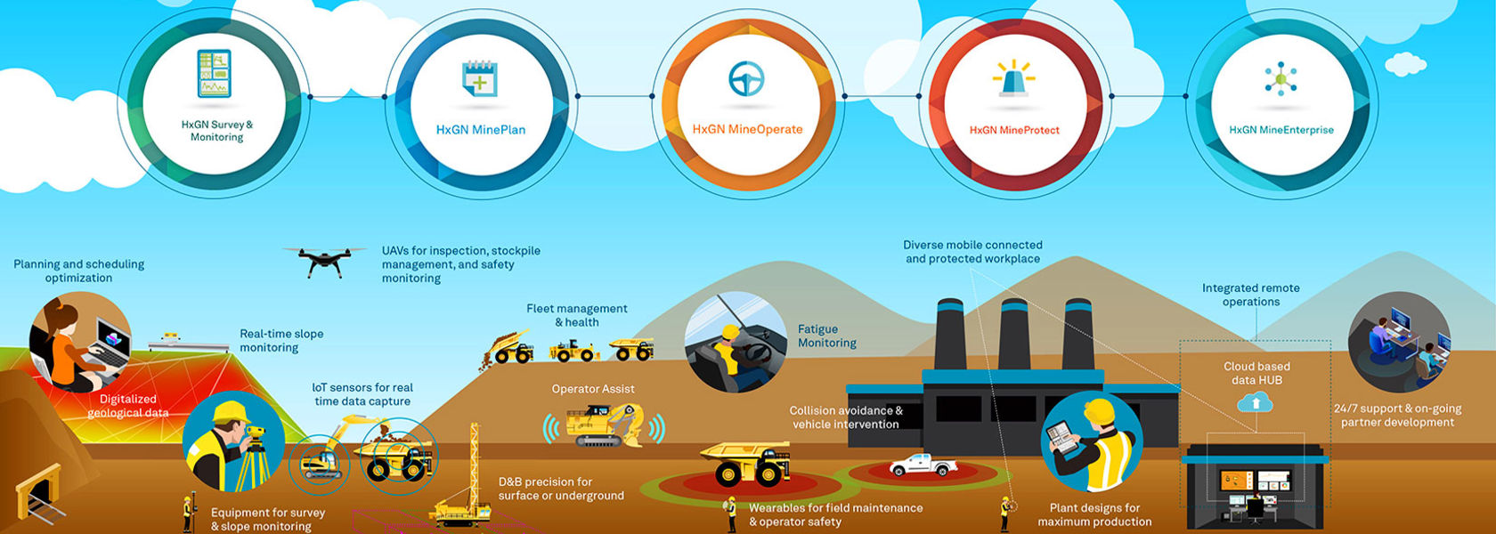
Mining

Slide 94
Transport
Route Optimization & Planning
Online Booking and Tracking
Parking Information
Transport & Fleet Management
Inventory Management

Slide 95
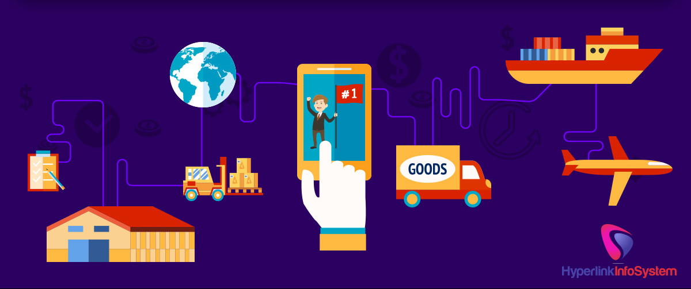
Transport

Slide 96



Transport

Slide 97


Transport

Slide 98

Transport

Slide 99


Financial Apps.

Slide 100

Financial Apps.

Slide 101


Financial Apps.

Slide 102


Financial Apps.

Slide 103

Financial Apps.

Slide 104

Financial Apps.

Slide 105

Financial Apps.

Slide 106


Financial Apps.

Slide 107







Financial apps in Liberia

Slide 108

Artificial Intelligence

Slide 109

Artificial Intelligence
AI, or Artificial Intelligence, refers to the simulation of human intelligence in machines that are programmed to think and learn like humans.

Slide 110

Categories of AI

Slide 111

Categories of AI

Slide 112




AI Technologies
Image recognition
Virtual Assistant

Slide 113



AI Technologies
Autonomous Vehicles
Fraud Detection
Notes:
Trainers should use ChatGPT and ant Text-to-image software

Slide 114
Exercise
Create an account with “www.openai.com”
Type what are the digital skills needed in your field (e.g Education)

Slide 115
Digital Security

Slide 116

Digital Security: Password Security
A strong password typically includes a combination of:
uppercase and lowercase letters
Numbers, and
special characters.

Slide 117

Digital Security: Two-Factor Authentication (2FA)
It requires two form of verification.
First: Password
Second: could be a code sent to your mobile device

Slide 118

Digital Security: Software Update
Includes patches and fixes for vulnerabilities that hackers could exploit.

Slide 119

Digital Security: Secure Internet Connection
Don’t perform sensitive transactions on public Wi-Fi
Often Unsecured
Free WiFi on Airports or restaurants

Slide 120


Digital Security: Safe Browsing
Beware of suspicious links and attachments.
Look for websites with HTTPS,
Use antivirus and anti-malware

Slide 121

Digital Security: Use Antiviruses
Guardians for your device, scanning for and removing harmful software

Slide 122

Digital Security: Backup Regularly
Consider using cloud storage services or external hard drives to store backups.
Back up pictures, videos, audio, documents and contacts

Slide 123

Digital Security: Social Engineering
Online scam
Deception to get Passwords or payment details.
They use text messages, emails, links, calls

Slide 124

Digital Security: Online Shopping and Financial Transactions
Use secured websites with "https://" in the website address.
Regularly monitor your bank account or e-wallets statements
Be cautious of sharing financial information

Slide 125

Congratulations
You have become Digital Literate

